Slide 1
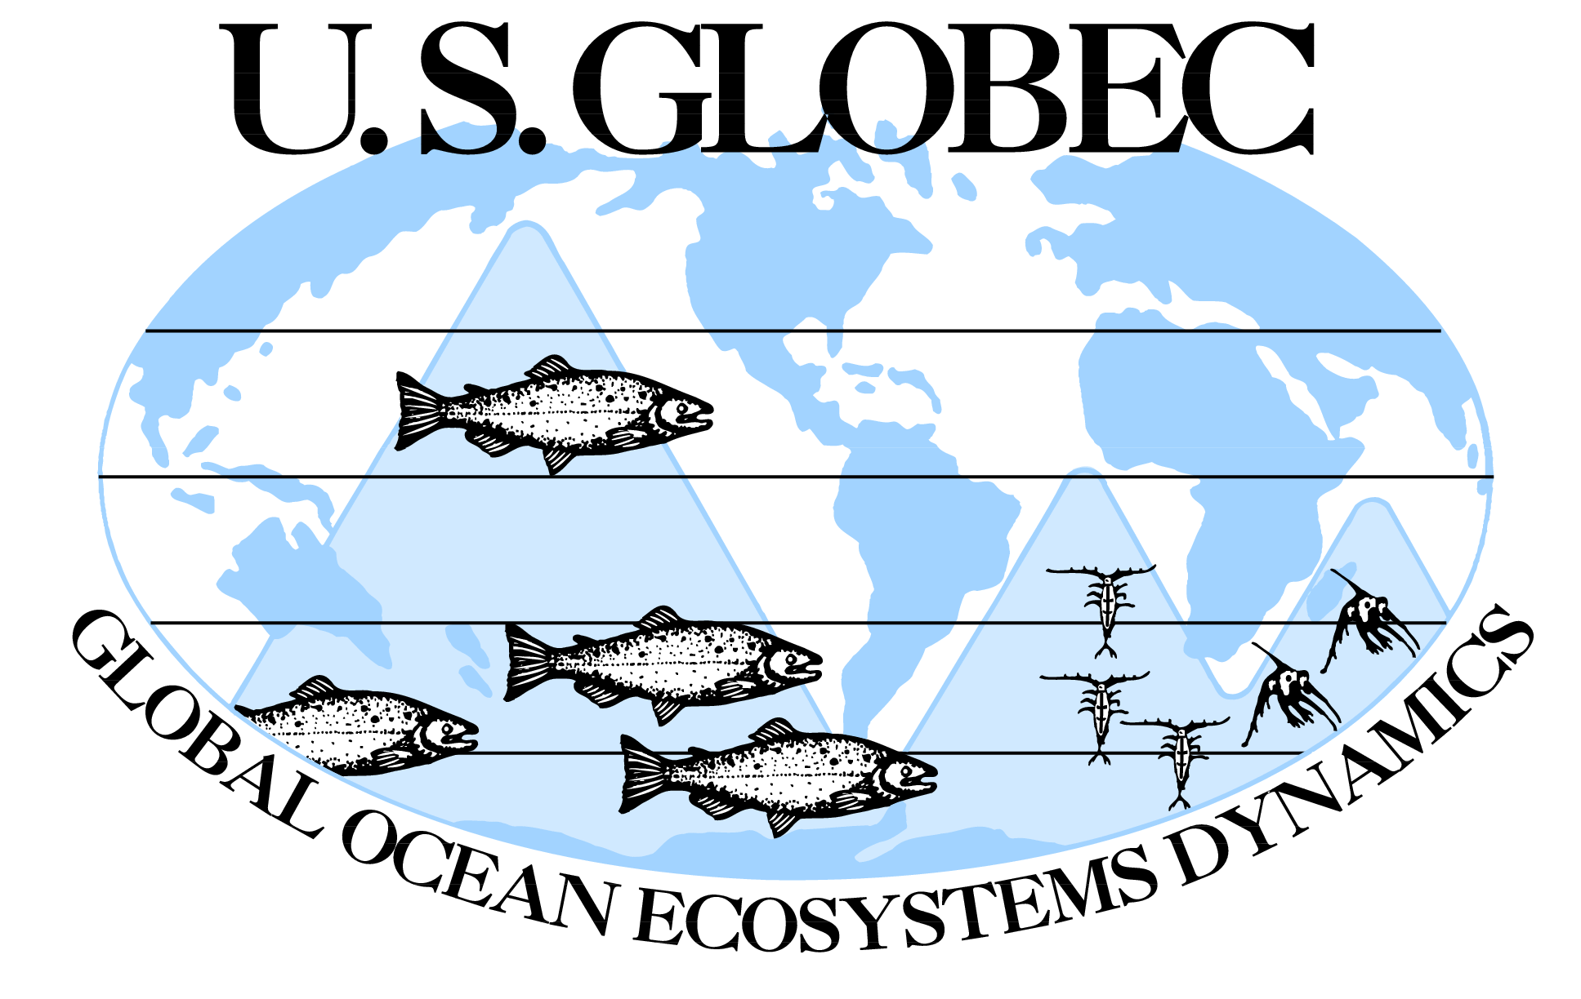
Strategies for Success
Notes:
Phil gave us a short history of the development of the program.
I will focus on program attributes that helped lead to success.
These include:
Multi-disciplinary, multiple approaches
Regional studies nested in global context
Focus on target species
Long-term funding commitment
Partnerships across several levels
Specific phases for synthesis

Slide 2
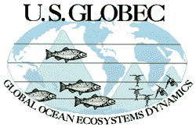
U.S. GLOBEC
Global Ocean Ecosystems Dynamics
GOAL: Identify how a changing global climate will affect the abundance and dynamics of marine animal populations
STRATEGY: Focus on processes linking climate variables -> physical processes in the ocean-> population dynamics of marine animals
OUTCOME: Knowledge of the coupling between physical and biological processes that can inform assessments and predictions of the impact of climate change on marine ecosystems
Notes:
Lofty goal, complex issues, targeted outcomes

Slide 3
The GLOBEC Approach
Process studies for mechanistic understanding at limited time periods
Field observations for longer-term ( 5-yr) context, seasonal changes
Retrospective studies for very long-term context
Technological innovations to fuel progress
Modeling to assimilate and synthesize findings
Synthesis to bring it all together
Synthesis
Modeling
Field Observations
Process Studies
Retrospective Analysis
Technological Innovation
Notes:
Comprehensive, multi-disciplinary integrative approach.
Covering time and space scales appropriate to marine populations

Slide 4
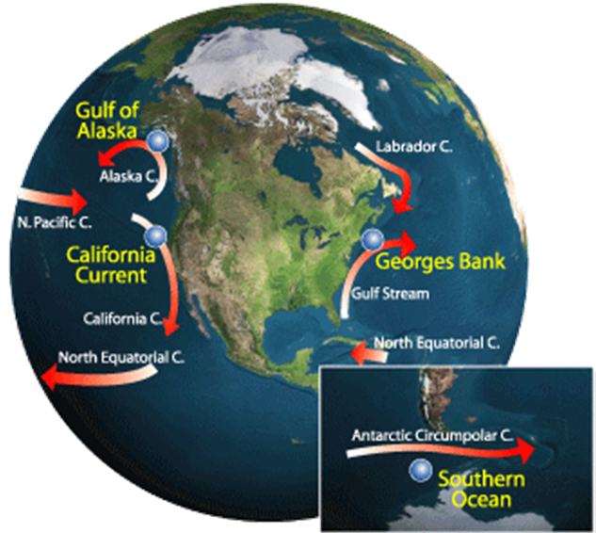
U.S. GLOBEC
Regional Study Areas
Northwest Atlantic
  Density-driven retentive circulation
Northern California Current
  Wind-driven seasonal upwelling
Gulf of Alaska
  Wind and buoyancy-driven seasonal downwelling
Southern Ocean
  Ice-dominated
Notes:
Important aspect was the recognition that global climate impacts will be expressed at the regional scale.
Regions were chosen as areas where climate and marine populations might be expected to show impacts.
Different physical processes in different regions allowed comparisons and contrasts between regions

Slide 5
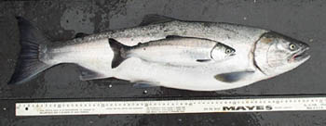
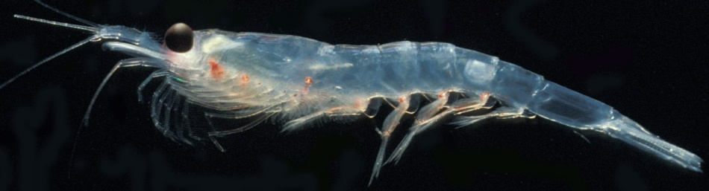
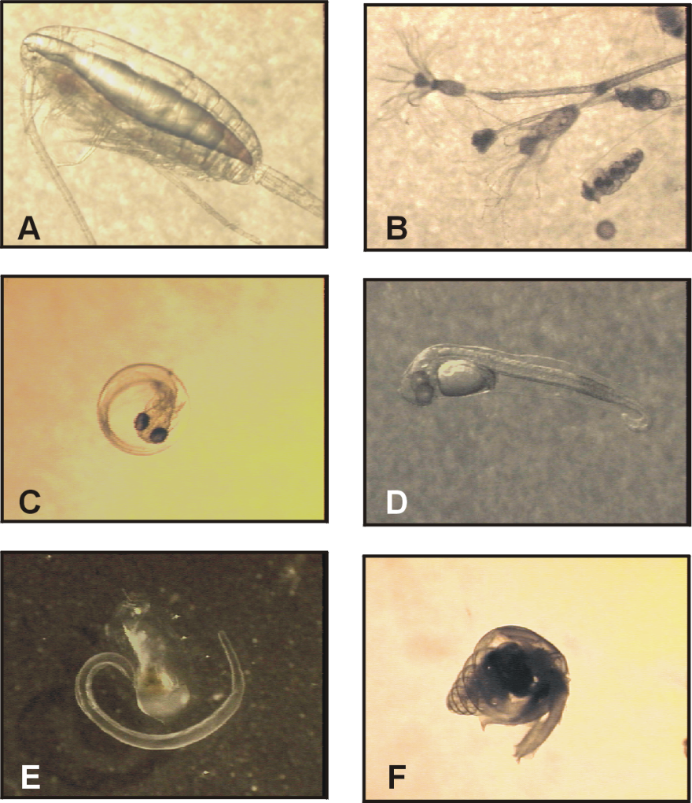
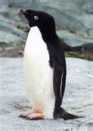
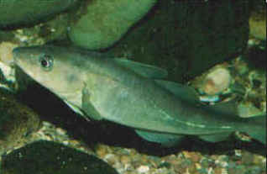
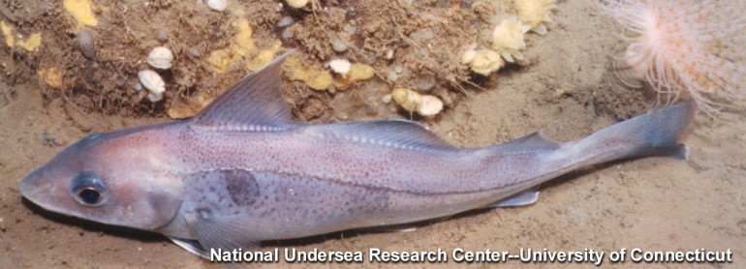
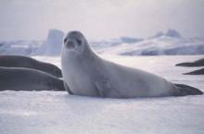
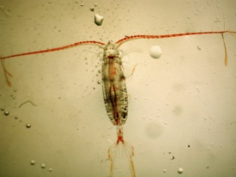
Target Species
Notes:
Another important aspect was the fact that the impacts will be on real animals, not carbon units or boxes of energy.
Organism-based, allowed targeted process studies on representative species.
Chosen for ecological and economic importance.

Slide 6
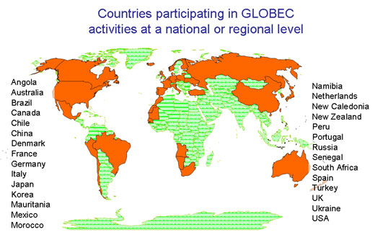



International Context
Notes:
US GLOBEC regional studies benefitted from international efforts through GLOBEC International, ICES, PICES.
Wider comparisons, broader conclusions, extrapolation of results.
Ian Perry will discuss this more during the symposium

Slide 7
Long-Term Funding
GLOBEC Phases
91 | 92 | 93 | 94 |  | 95 | 96 |  | 97 | 98 | 99 |  | 00 |  | 01 | 02 | 03 | 04 |  | 05 | 06 | 07 | 08 | 09 | 10
Modeling And Retro Analysis |  |  | NWA Field Ph I |  |  | NWA Field Ph II |  |  | NWA Field Ph III |  |  |  |  | NWA Syn1 |  |  |  |  | NWA Syn2 |  |  | Pan- Regional Synth.
 |  |  |  |  |  |  |  |  | NEP Phase I: CA Current |  |  |  |  |  |  |  |  | CA Current Syn
 |  |  |  |  |  |  |  |  |  |  |  |  | NEP Phase II: Gulf of AK |  |  |  |  |  | G of AK Syn
 |  |  |  |  |  |  |  |  |  |  |  |  | SO Field |  |  |  |  |  |  | SO Syn
Notes:
Complex program such as GLOBEC required long-term commitment to funding.
Phased approach allowed several regions to come into the program sequentially
Separate modeling and retrospective analysis phase at beginning, separate synthesis phases at the end.

Slide 8

Partnerships
Across disciplines:
  Physical and biological oceanography, fisheries scientists, ocean modelers
Across sectors: Academic and Federal
  Academic scientists from >30 institutions nationwide collaborate with researchers from NMFS, OAR/ERLs and U.S. Naval Postgraduate School
Notes:
Important for GLOBEC to bridge disciplines (Eileen may discuss further)
Physical and biological sampling on same space and time scales
Integration of modeling with field studies
Academic/Federal scientists working together allowed for cutting-edge science to be incorporated into NOAA work, and gave application pathway for academic science.

Slide 9

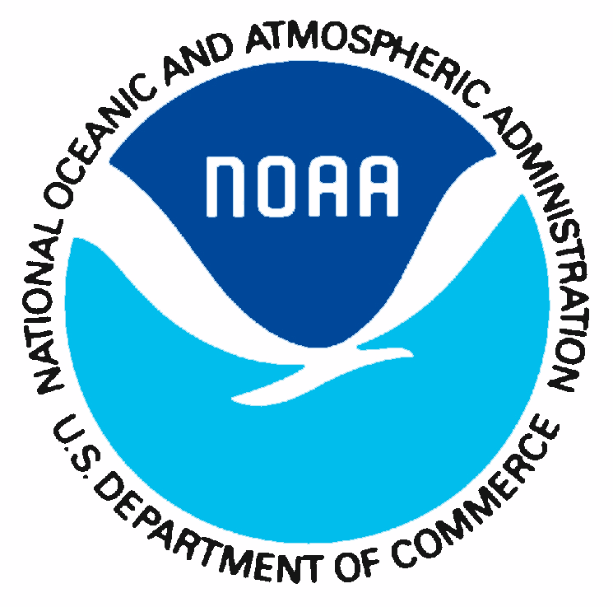





Partnerships
Across Federal agencies
  NSF, NOAA
  ONR, NASA
Across NOAA
  National Ocean Service
  National Marine Fisheries Service
    Regional Fisheries Science Centers in NE, NW, AK, SW
  Ocean & Atmosphere Research
Notes:
Partnership across Federal agencies provided strong basis for program, was precursor to NOPP program.
Cross-NOAA partnerships strengthened “one-NOAA” approach to issues.

Slide 10
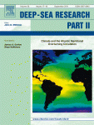
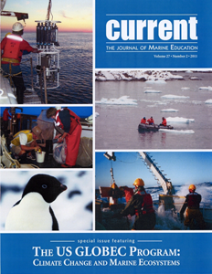
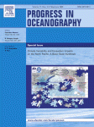
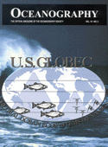

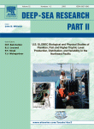
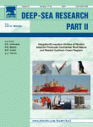
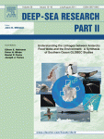
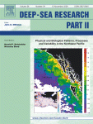
Regional Syntheses: Special Journal Issues
Notes:
Regional synthesis phases gave scientists time to catch their breath from field work and focus on what the data meant.
Often resulted in special publications that showed program accomplishments to wider scientific community.
The US GLOBEC Program: Climate Change and Marine Ecosystems. CURRENT Volume 27, Number 2 (2011).
Physical and Biological Patterns, Processes and Variability in the Northeast Pacific. Deep Sea Research Part II Volume 56, Issue 24, Pages 2405-2578, (2009).
Climate Variability and Ecosystem Impacts on the North Pacific: A Basin-Scale Synthesis. Progress in Oceanography: Volume 77, Issues 2-3, Pages 83-268, (2008).
U.S. GLOBEC Biological and Physical Studies of Plankton, Fish, and Higher Trophic Level Production, Distribution, and Variability in the Northeast Pacific. Deep Sea Research Part II Volume 52, Issues 1-2, Pages 1-374, (2005).
Southern Ocean GLOBEC Special Issue I. DSR Part II Volume 51, Issues 17-19, Pages 1914-2344, (2004).
U.S. GLOBEC: Physical Processes on Georges Bank (GLOBEC): Special Section . Journal of Geophysical Research Volume 108, Number C11, (2003).
Physical and Biological Conditions and Processes in the Northeast Pacific Ocean. Progress in Oceanography Volume 53, Issues 2-4, Pages 105-411, (2002).
U.S. GLOBEC Program Profile. Oceanography Volume 15, Number 2 (2002).
Georges Bank Special Issue II. DSR Part II Volume 48, Issues 1-3, pages 1-684 (2001).
Georges Bank Special Issue I. DSR Part II Volume 43, Issues 7-8, pages 1437-2006 (1996).

Slide 11
Pan-Regional Synthesis
Integrated understanding of physical and biological processes controlling population dynamics of target organisms
  Powell, Hofmann, Mountain, Runge, Costa
Evaluate how a varying climate may influence these populations
  Schwing, Houde (Powell, Mountain)
Use knowledge, techniques, and technologies to improve prediction of marine systems for management purposes
  Peterson, Murawski, Werner
Notes:
Pan-regional synthesis focused on larger issues and more comprehensive analyses.
Talks today and tomorrow will focus on the synthesis goals.

Slide 12
GLOBEC Legacy
Data, papers, special volumes, books
Model advances and model products
Advancing ecosystem-based management
Informing ocean observing systems
  Data Management (BCO-DMO)
Cadre of graduate students trained
  Haidvogel, Friedlander, Keister, Curchitser
Influencing scientific programs to follow
  Hofmann, Gagosian, Koehl
Notes:
SSC has had long discussions on the legacy of U.S. GLOBEC. We believe that U.S. GLOBEC will have impacts on the community for many years to come.
Several of these will be discussed in subsequent symposium talks.

Slide 13

    Multi-disciplinary, multiple approaches
    Regional studies nested in global context
    Focus on target species
    Long-term funding commitment
    Partnerships across several levels
    Regional-level and pan-regional syntheses
Notes:
US GLOBEC had:
Multi-disciplinary, multiple approaches
Regional studies nested in global context
Focus on target species
Long-term funding commitment
Partnerships across several levels
Regional-level and pan-regional synthesis
All led to program success.
I am proud to have been associated with the program, and look forward to the symposium’s highlights of program accomplishments.
Intro for Larry Robinson

